Slide 1
Prestige cars normalization
Presented by GROUP#3

Slide 2
Overview of the project
The Prestige Cars database normalization project involves restructuring the schema, introducing new tables, and ensuring compliance with best practices for database design. The objectives include schema redesign, data cleansing, and indexing for optimized performance.

Slide 3
Introduction
This document outlines the process of normalizing the Prestige Cars database into a relational database in 3NF. The project aims to enhance data integrity, promote reuse through user-defined datatypes, and implement robust constraints for data validation. The deliverables include a database backup file and an annotated presentation.

Slide 4
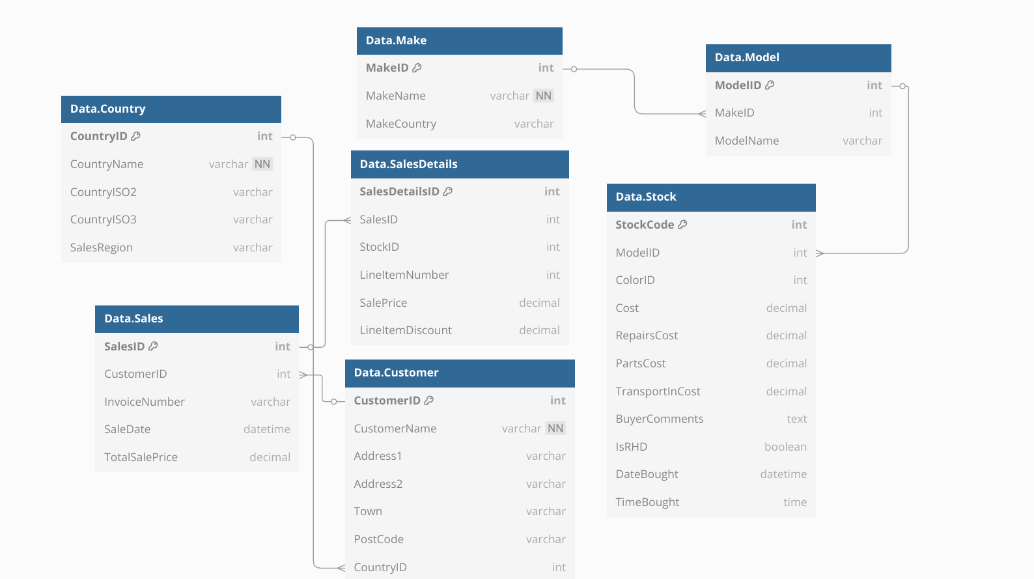

Slide 5
📘 Summary Table Of Cardinality
From Table | To Table | Cardinality | Notes
Country | Customer | 1:N | Each country has many customers
Country | Make | 1:N | Each country can be origin of many makes
Color | Stock | 1:N | Each color used in many vehicles
Make | Model | 1:N | A make has many models
Model | Stock | 1:N | A model maps to many stock vehicles
Customer | Sales | 1:N | A customer can place many sales orders
Sales | SalesDetails | 1:N | A sale has many line items
Stock | SalesDetails | 1:1 or 1:N | Ideally 1:1 (one car sold once)
Color | PivotTable | 1:1 | One color per Pivot row

Slide 6
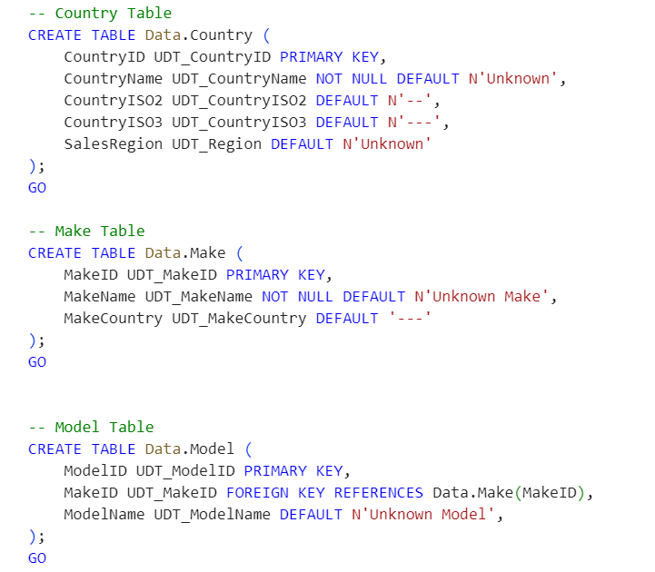
Step 2. recreate tables use the script to make constrains and checks. Use the udts
– ashly

Slide 7
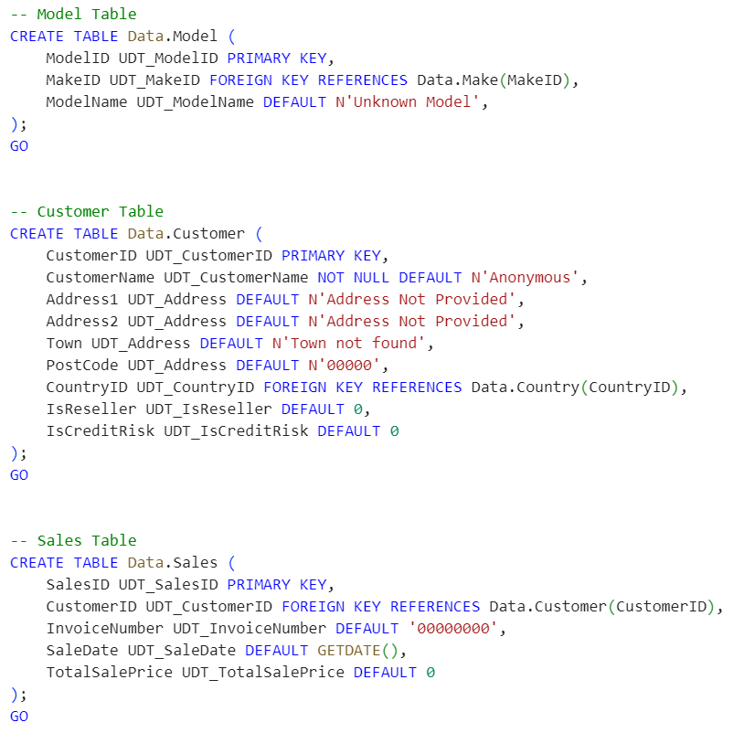
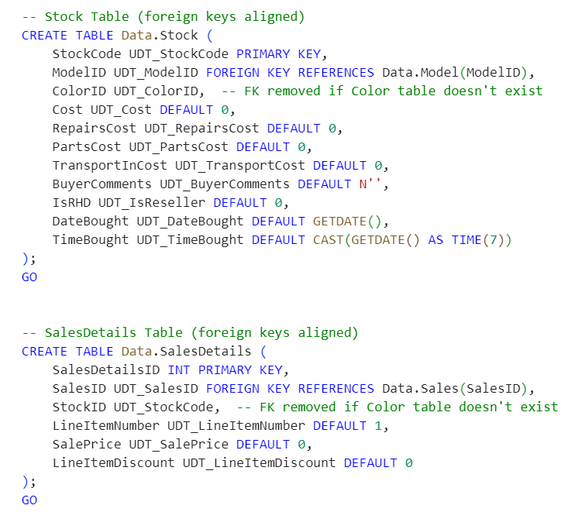
– ashly

Slide 8
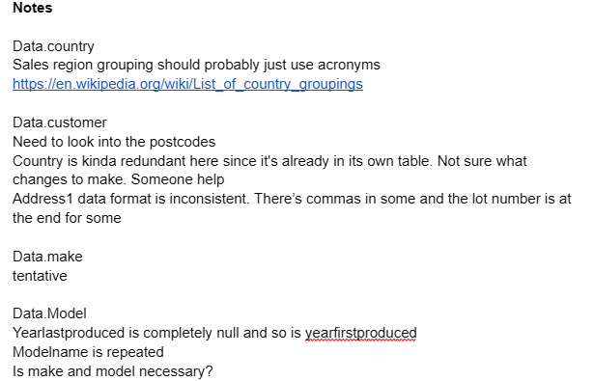
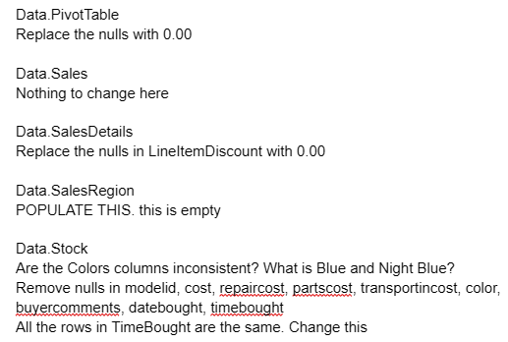
Notes as a "driver" What does it mean to clean up the tables?
Maitri

Slide 9
Data Normalization Steps: 1. Create Schemas and User-Defined Types 2. DefineTables (3NF) 3. Insert and Clean Data 4. Create Utility Procesdures (Truncate and Drop FKs) 5. Create Views and Functions 6. Validation and Verificaton
Mehtab

Slide 10
Data Normalization Steps: 1. Create Schemas and User-Defined Types i) Create new 3NF database and switch context ii) Create schemas to organiza tables iii) Define all UDTs if they did not exist already for all tables
Mehtab

Slide 11
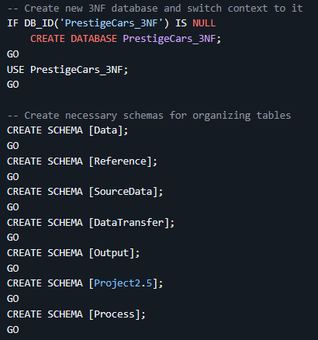
->

Slide 12
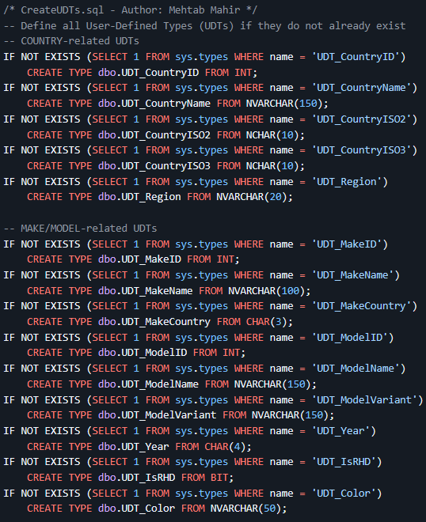
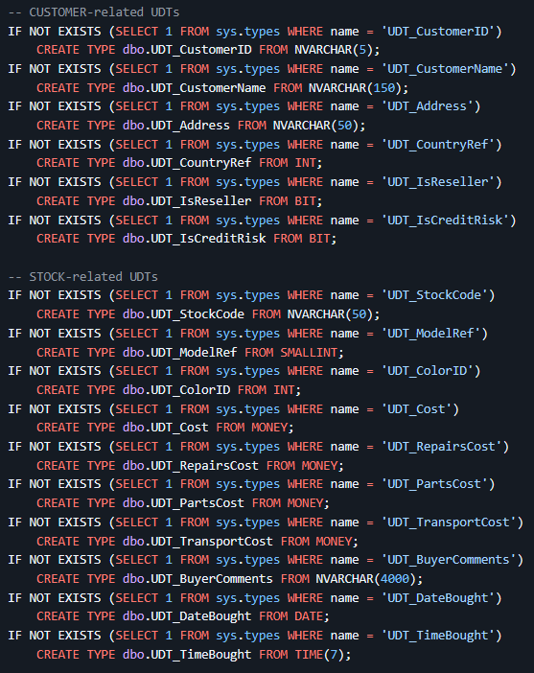
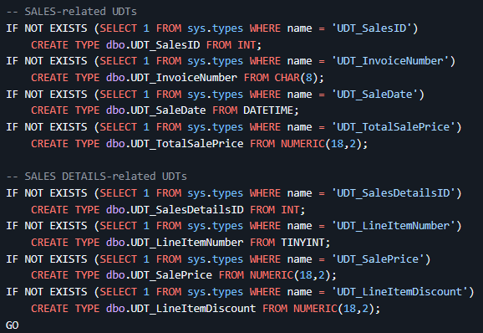
->

Slide 13
Data Normalization Steps: 2. DefineTables (3NF) i) Reference schema tables ii) Data schema tables iii) DataTransfer schema tables iv) SourceData schema tables v) Output schema tables The steps taken for all the schema tables were to Drop the table if it exists then create new tables with the user defined types.
Mehtab

Slide 14
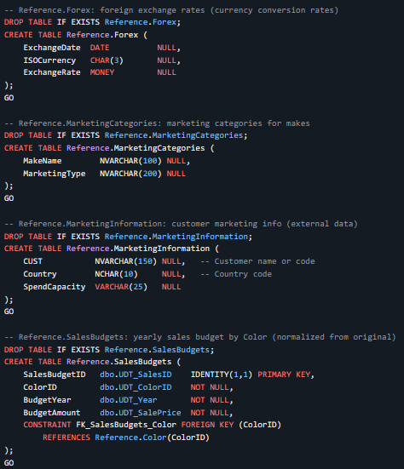
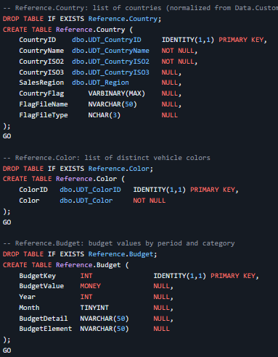
->
reference schema tables

Slide 15
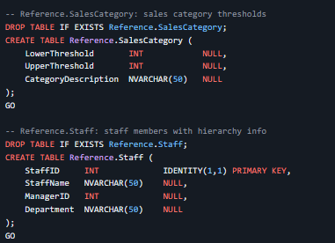
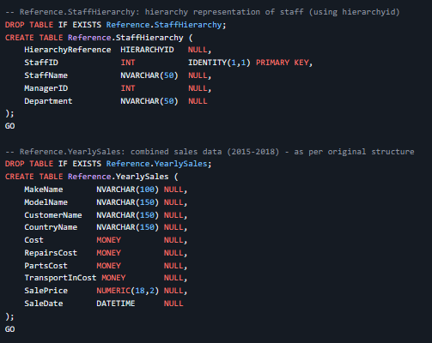
->
Rreference schema tables

Slide 16
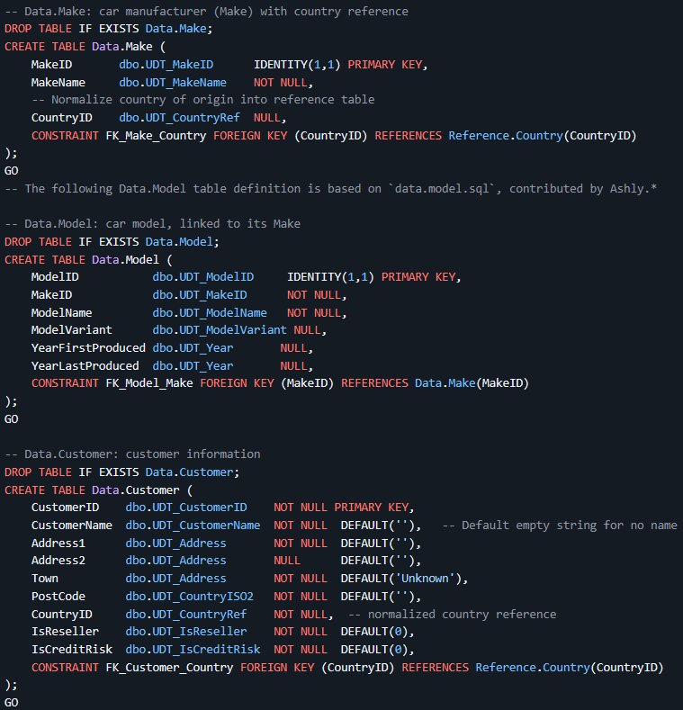
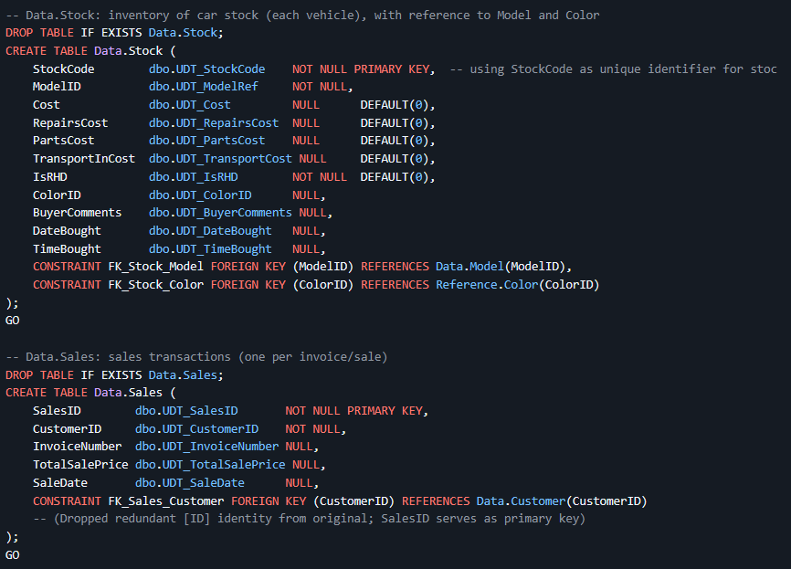
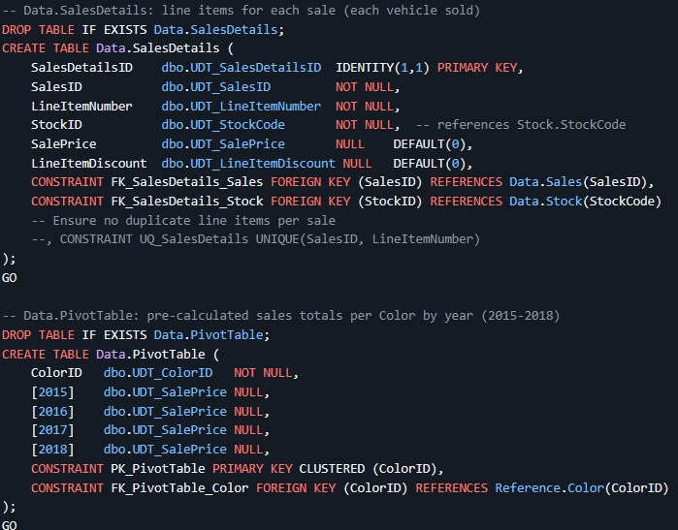
->
RData schema tables

Slide 17
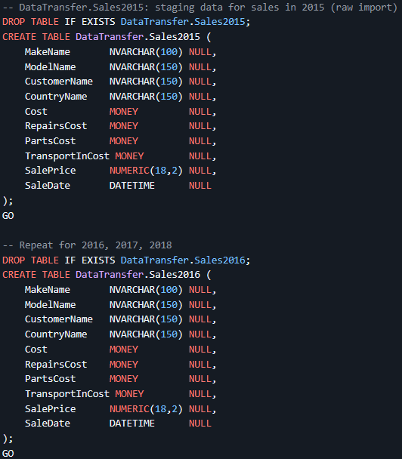
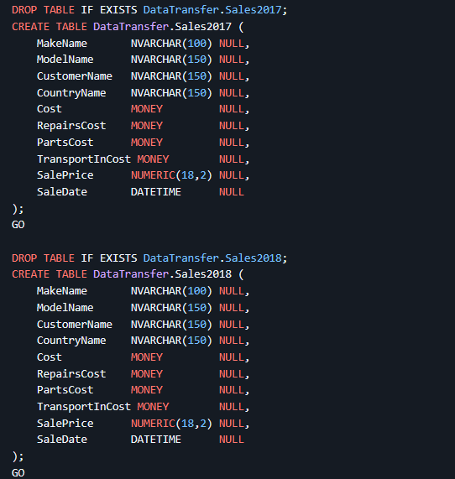
->
DataTransfer schema tables

Slide 18
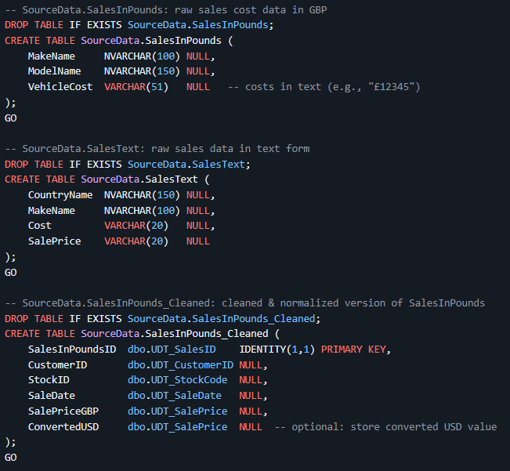
->
ourceData schema tables

Slide 19
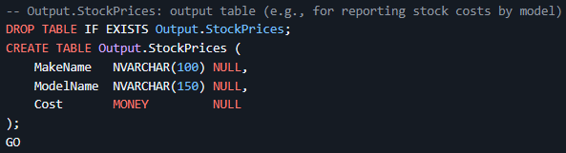
->
Output schema tables

Slide 20
Data Normalization Steps: 3. Insert and Clean Data The steps here was to transfer all data from PrestigeCars into the new normalized Databse all while cleaning the data.
Mehtab

Slide 21
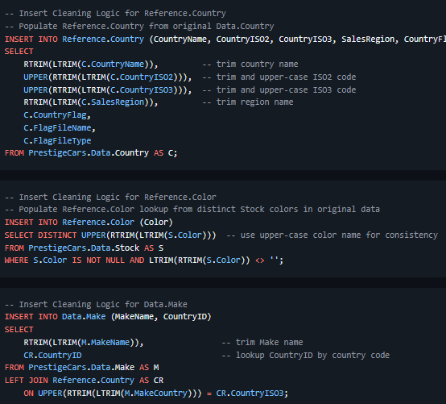
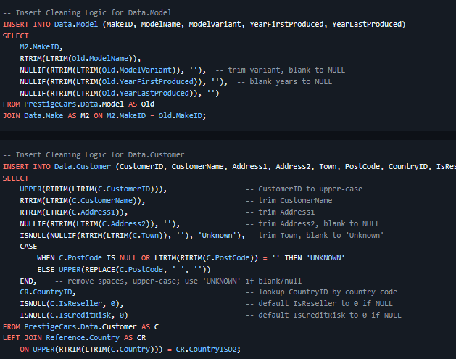
->

Slide 22
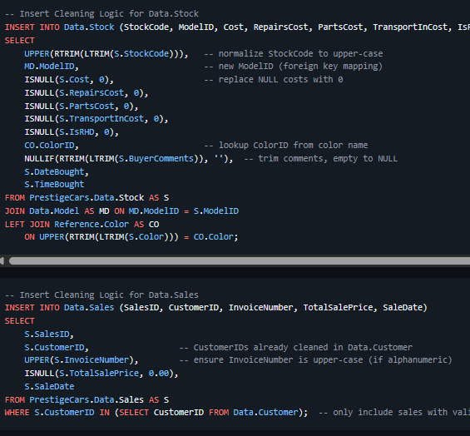
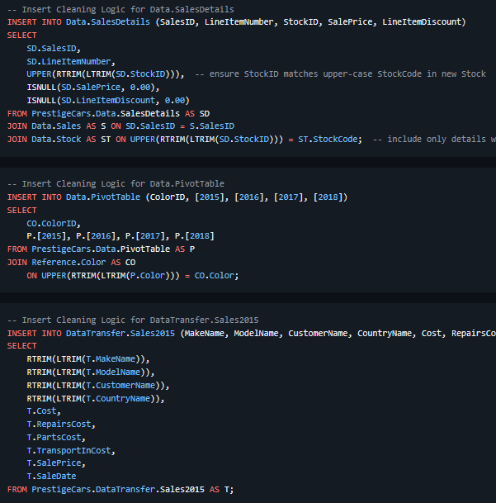
->

Slide 23
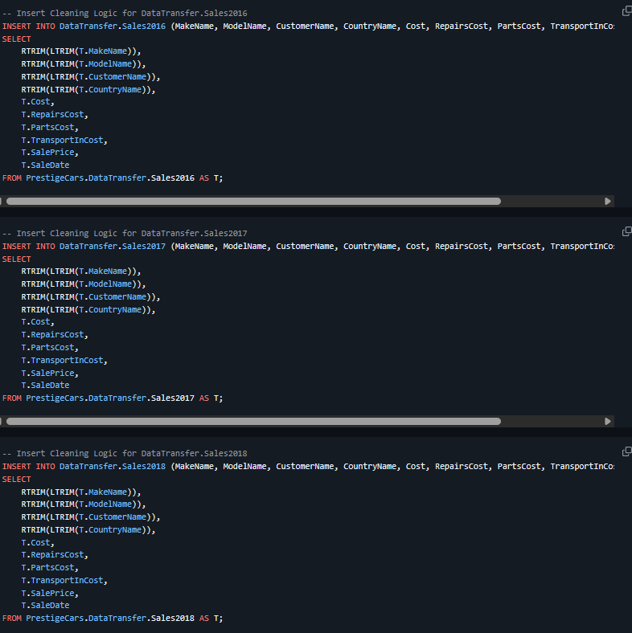
->

Slide 24
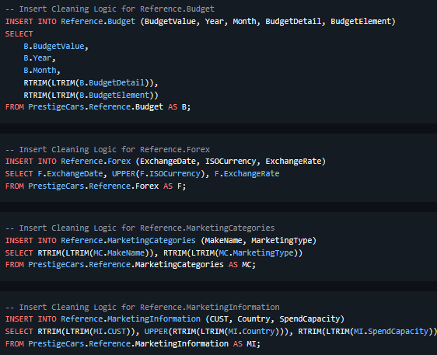
->

Slide 25
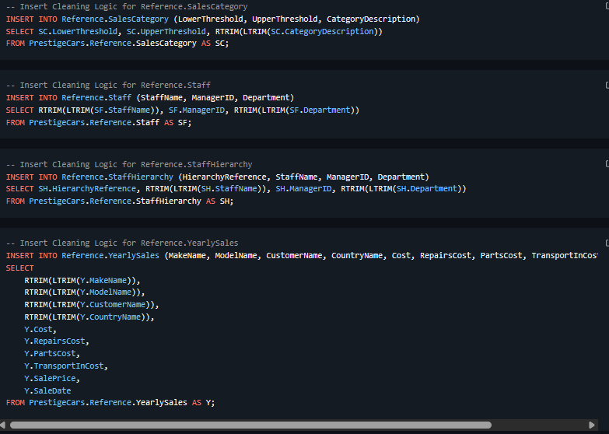
->

Slide 26
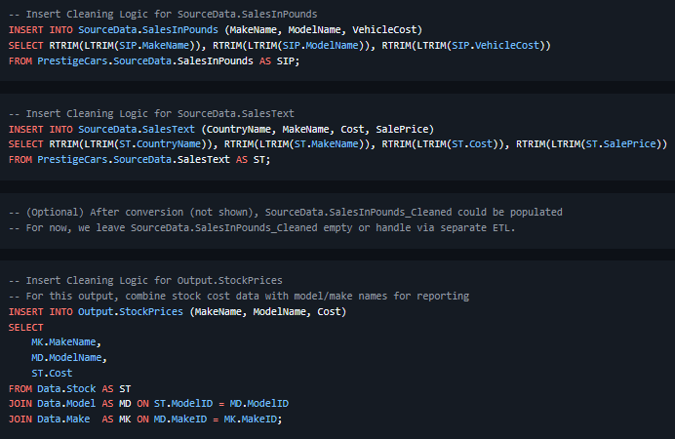
->

Slide 27
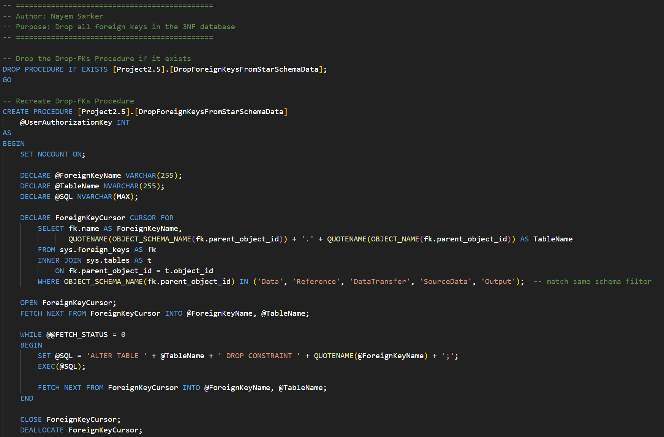
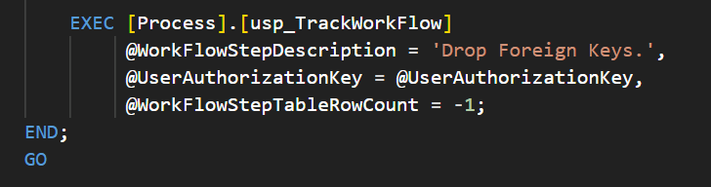

Slide 28
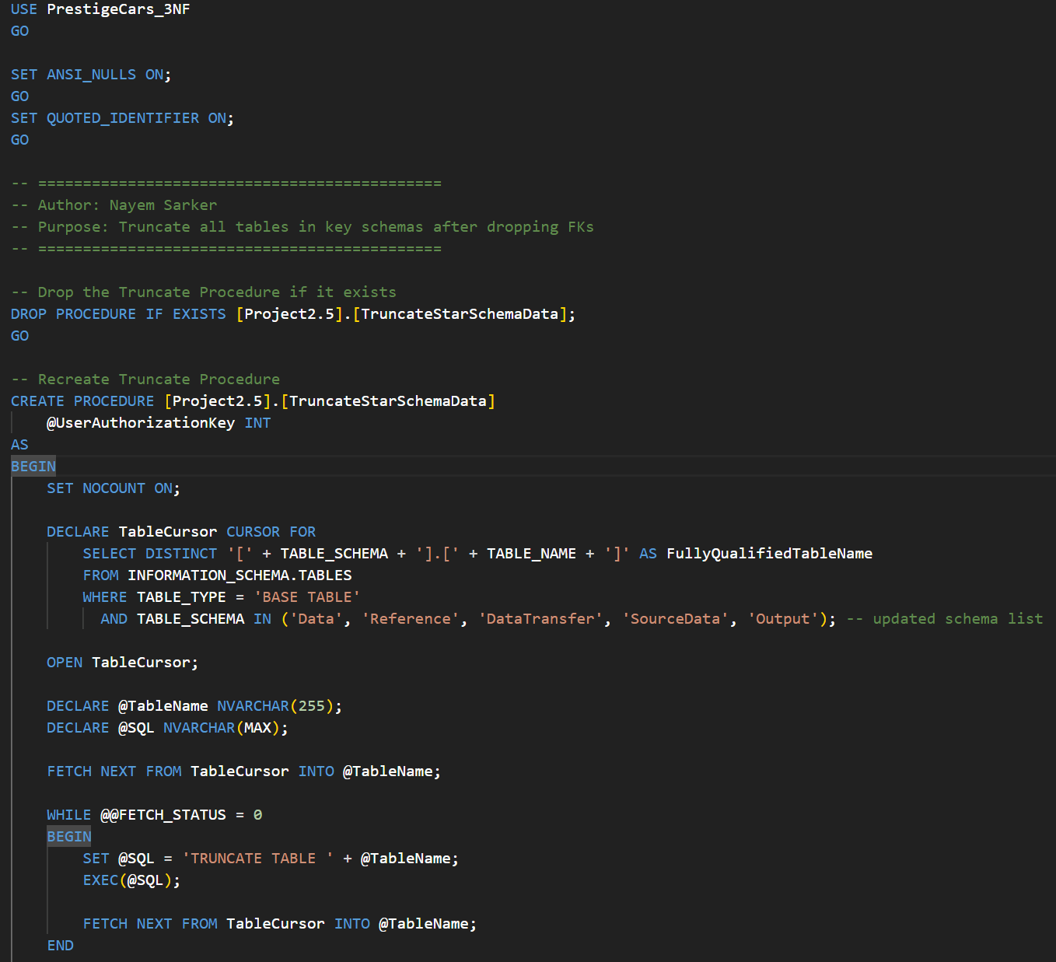
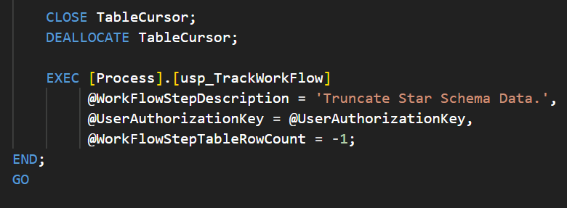

Slide 29
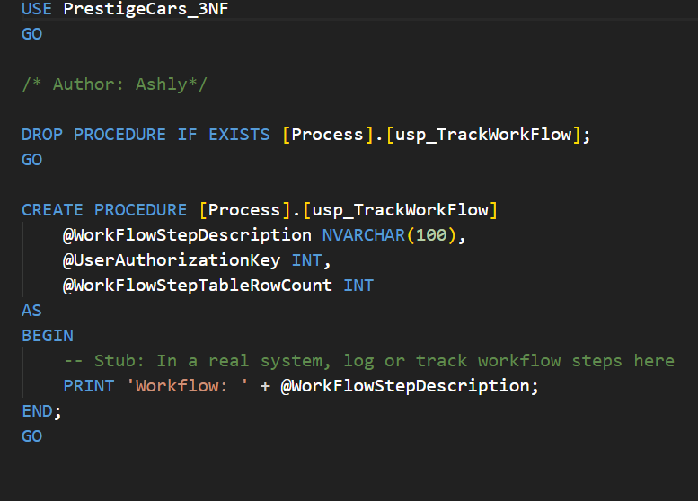

Slide 30
William Wang
Views

Slide 31
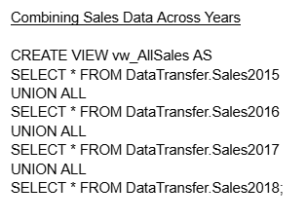
This query creates a view called vw_AllSales that simply just combines all the sales data from the tables of DataTransfer schema into one view(virtual table).
William Wang

Slide 32
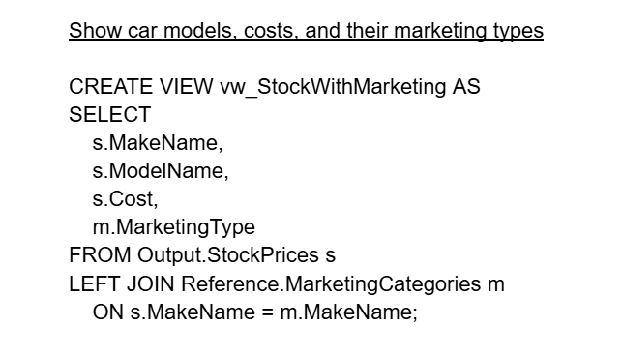
Combines car stock data(make, model, cost) with their corresponding marketing type. It uses a left join to include all stock items.
William Wang

Slide 33
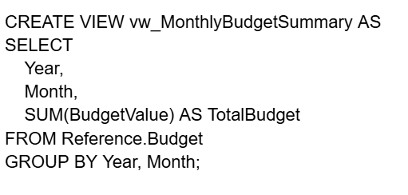
Calculates the total budge for each year and moth then provide a breakdown of totals overtime.
William Wang

Slide 34
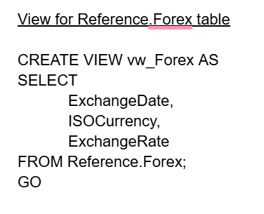
Shows exchange rates(date, currency, code, and rate) from the Forex table of Reference schema. Just a simple display.
William Wang

Slide 35
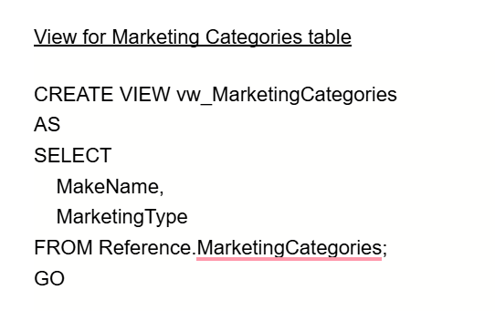
Extracts the MakeName(carbrand) and MarketingType from the Reference.MarketingCategories table.
William Wang

Slide 36
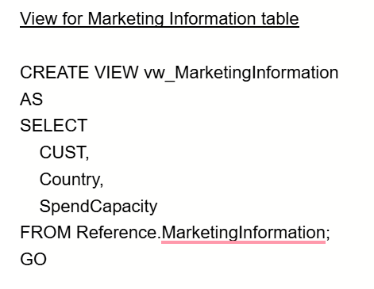
Displays CUST(customerid), Country, and SpendCapacity from the MarketingInformation table from Reference schema.
William Wang

Slide 37
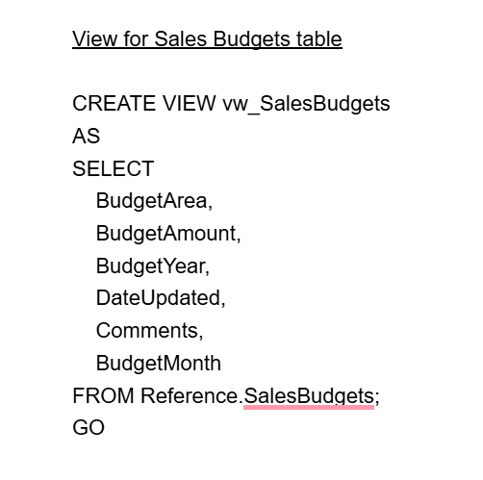
Displays budget details. Area, amount, year, month, date, and comments from the SalesBudgets table of the Reference schema.
William Wang

Slide 38
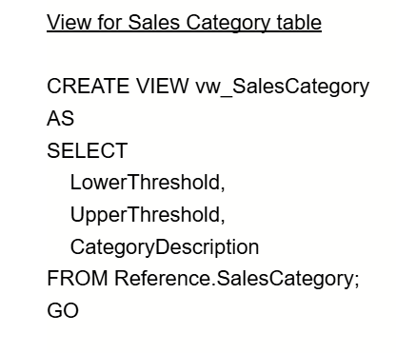
Retrieves the LowerThreshold, UpperThreshold, and CategoryDescription from the SalesCategory table from the Reference schema.
William Wang

Slide 39
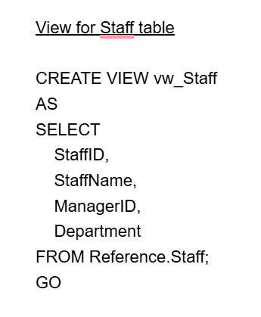
Displays StaffID, StaffName, ManagerID, and Department from the Reference.Staff table.
William Wang

Slide 40
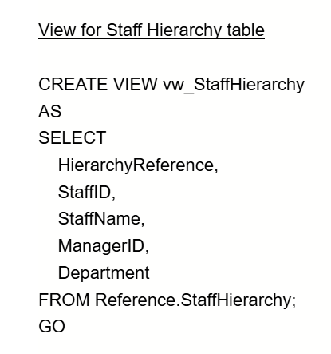
Retrieves HierarchyReference, StaffID, StaffName, ManagerID, and Department from the Reference.StaffHierarchy table.
William Wang

Slide 41
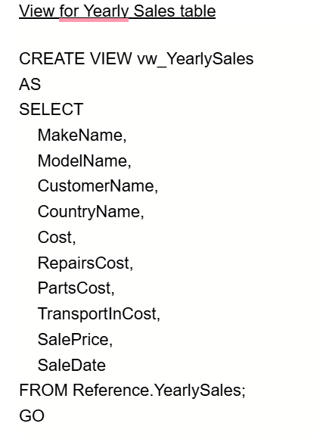
Extracts key sales transaction details—including vehicle make/model, customer, country, costs, sale price, and date—from the Reference.YearlySales table.
William Wang

Slide 42
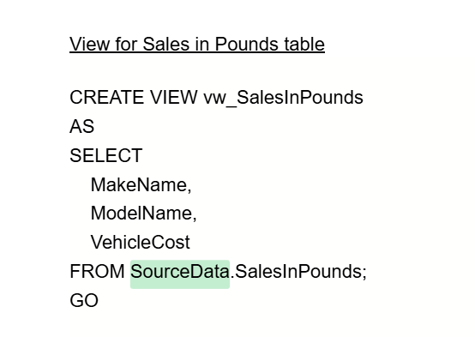
Displays three columns—MakeName, ModelName, and VehicleCost—from the SourceData.SalesInPounds table.
William Wang

Slide 43
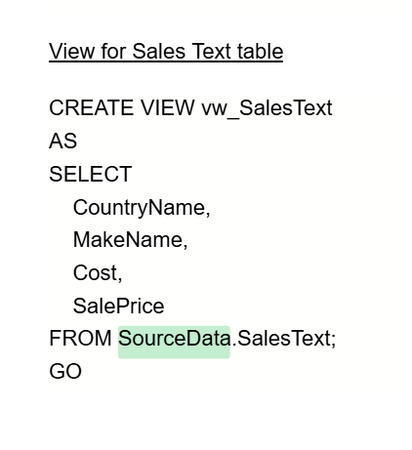
Displays CountryName, MakeName, Cost, and SalePrice from the SourceData.SalesText table.
William Wang

Slide 44
Inline table value functions (IVTFs)
WIlliam Wang

Slide 45
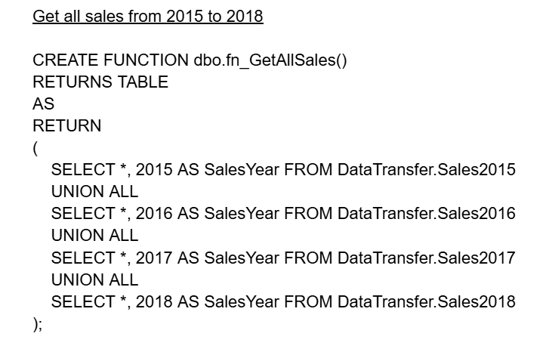
Combines sales data from four yearly tables (2015–2018) into a single result set. IVTFs are like parameterized views.
William Wang

Slide 46
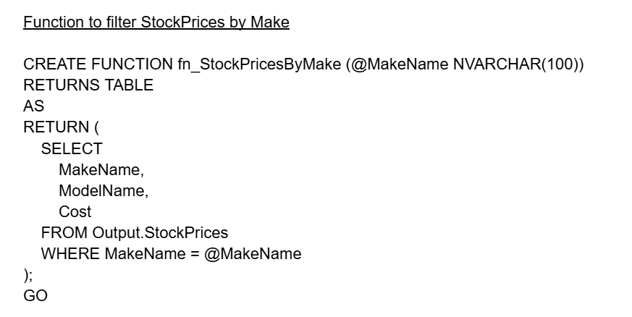
Returns a filtered list of vehicle stock prices (make, model, cost) based on a provided brand name (e.g., 'Toyota'). It acts like a parameterized view, allowing dynamic filtering when called in queries.
William Wang

Slide 47
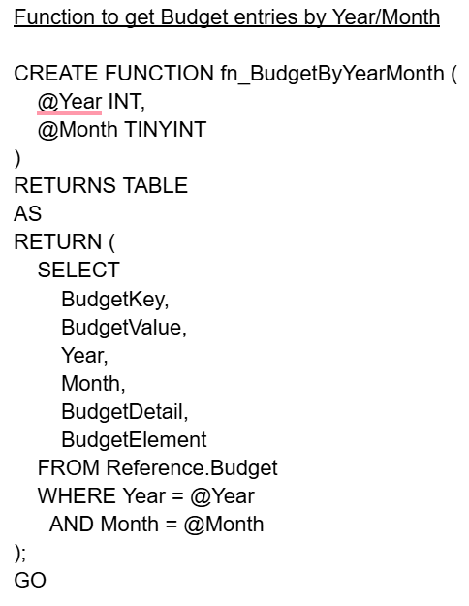
Extracts budget data for a specific year and month combination from the Reference.Budget table. The function returns key budget details including value, description, and elements, filtered dynamically by the input parameters.
William Wang

Slide 48

Retrieves exchange rate history for a specific 3-letter currency code (like 'USD' or 'EUR'). The function returns the date, currency code, and exchange rate filtered by the input parameter, acting like a targeted currency query tool.
William Wang

Slide 49

Returns marketing classifications (MakeName, MarketingType) filtered by a specific vehicle brand parameter. Acts as a parameterized lookup for marketing categories.
William Wang

Slide 50

Returns customer marketing data (CUST, Country, SpendCapacity) filtered by a specified country parameter.
William Wang

Slide 51

Returns sales budget details filtered by year and month parameters.
William Wang

Slide 52

Returns the sales category thresholds and description that match the specified value parameter. Identifies which predefined value range (e.g., "High", "Medium", "Low") the input falls into.
William Wang

Slide 53

Filters staff records by department parameter, returning employee IDs, names, manager IDs, and departments.
William Wang

Slide 54

Returns staff hierarchy records filtered by a specific manager ID parameter. Shows all employees who directly report to the given manager, including their department and hierarchy details.
William Wang

Slide 55

Filters yearly sales data between specified start and end date parameters. Returns comprehensive sales transaction details including vehicle, customer, costs, and pricing within the date range.
William Wang

Slide 56

Returns vehicle cost data in GBP filtered by specific make and model parameters. Provides targeted pricing lookup for individual vehicle configurations.
William Wang

Slide 57

Filters sales metrics (cost and sale price) by country and vehicle make parameters. Delivers market-specific pricing analysis for targeted brands.
William Wang

Slide 58
Check In
Have we normalized all tables into 3NF, created a comprehensive Physical Data Model, and noted the cardinality of relationships?
Did we create appropriate UDTs and document them?
Have we made constraints and ensured data integrity?
Have we made views and ITVFs?
Did we clean data from the original database and index our primary keys?
Did we document everyone's work?
Sabrina

Slide 59
THANK YOU
Normalization is important because it ensures a database is structured efficiently by minimizing data redundancy and enforcing data integrity. It organizes data into logical, related tables, which makes it easier to update, maintain, and understand. This leads to more accurate data, reduces the risk of inconsistencies, and supports scalability as the system grows. Overall, normalization is a foundational skill for designing clean, reliable, and high-performance databases.

